Slide 1

Student Performance Record Management
2020977, 2020975, 2022049, 2020600, 2022523, 2030069

Slide 2
Rich picture As is

Slide 3
Rich Picture To Be

Slide 4
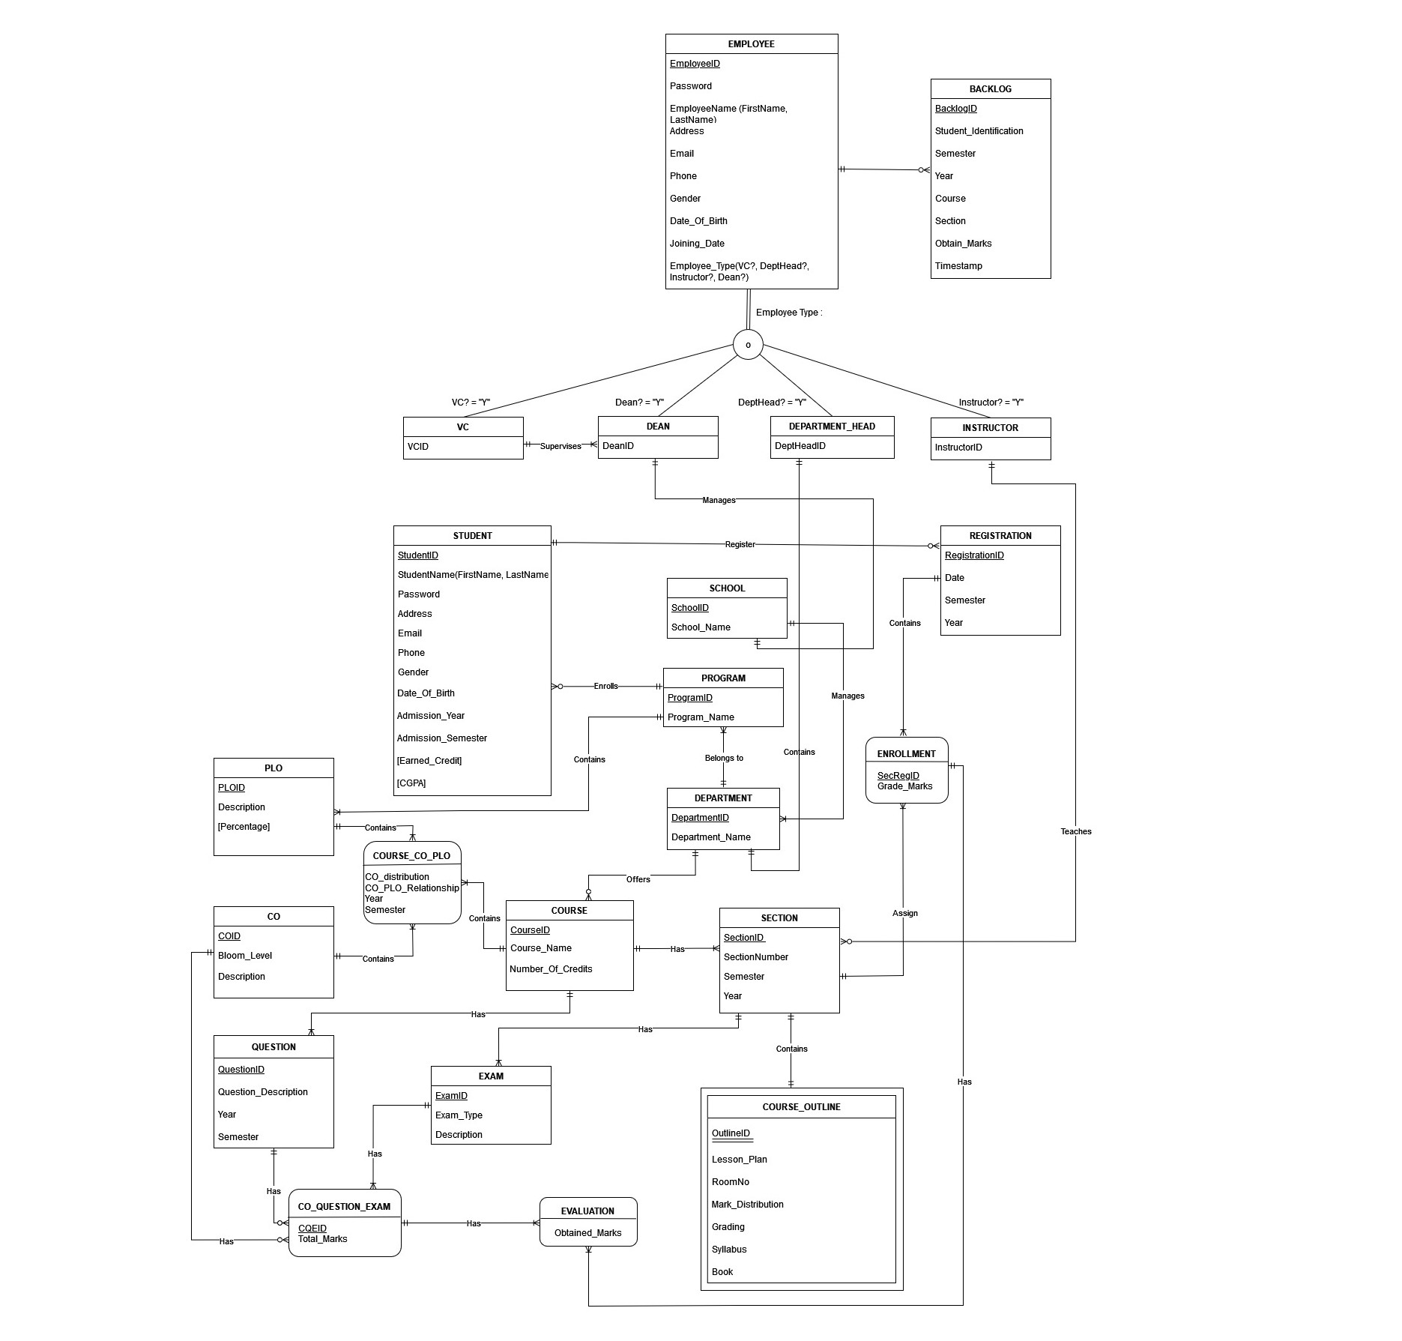
Entity Relation Diagram

Slide 5
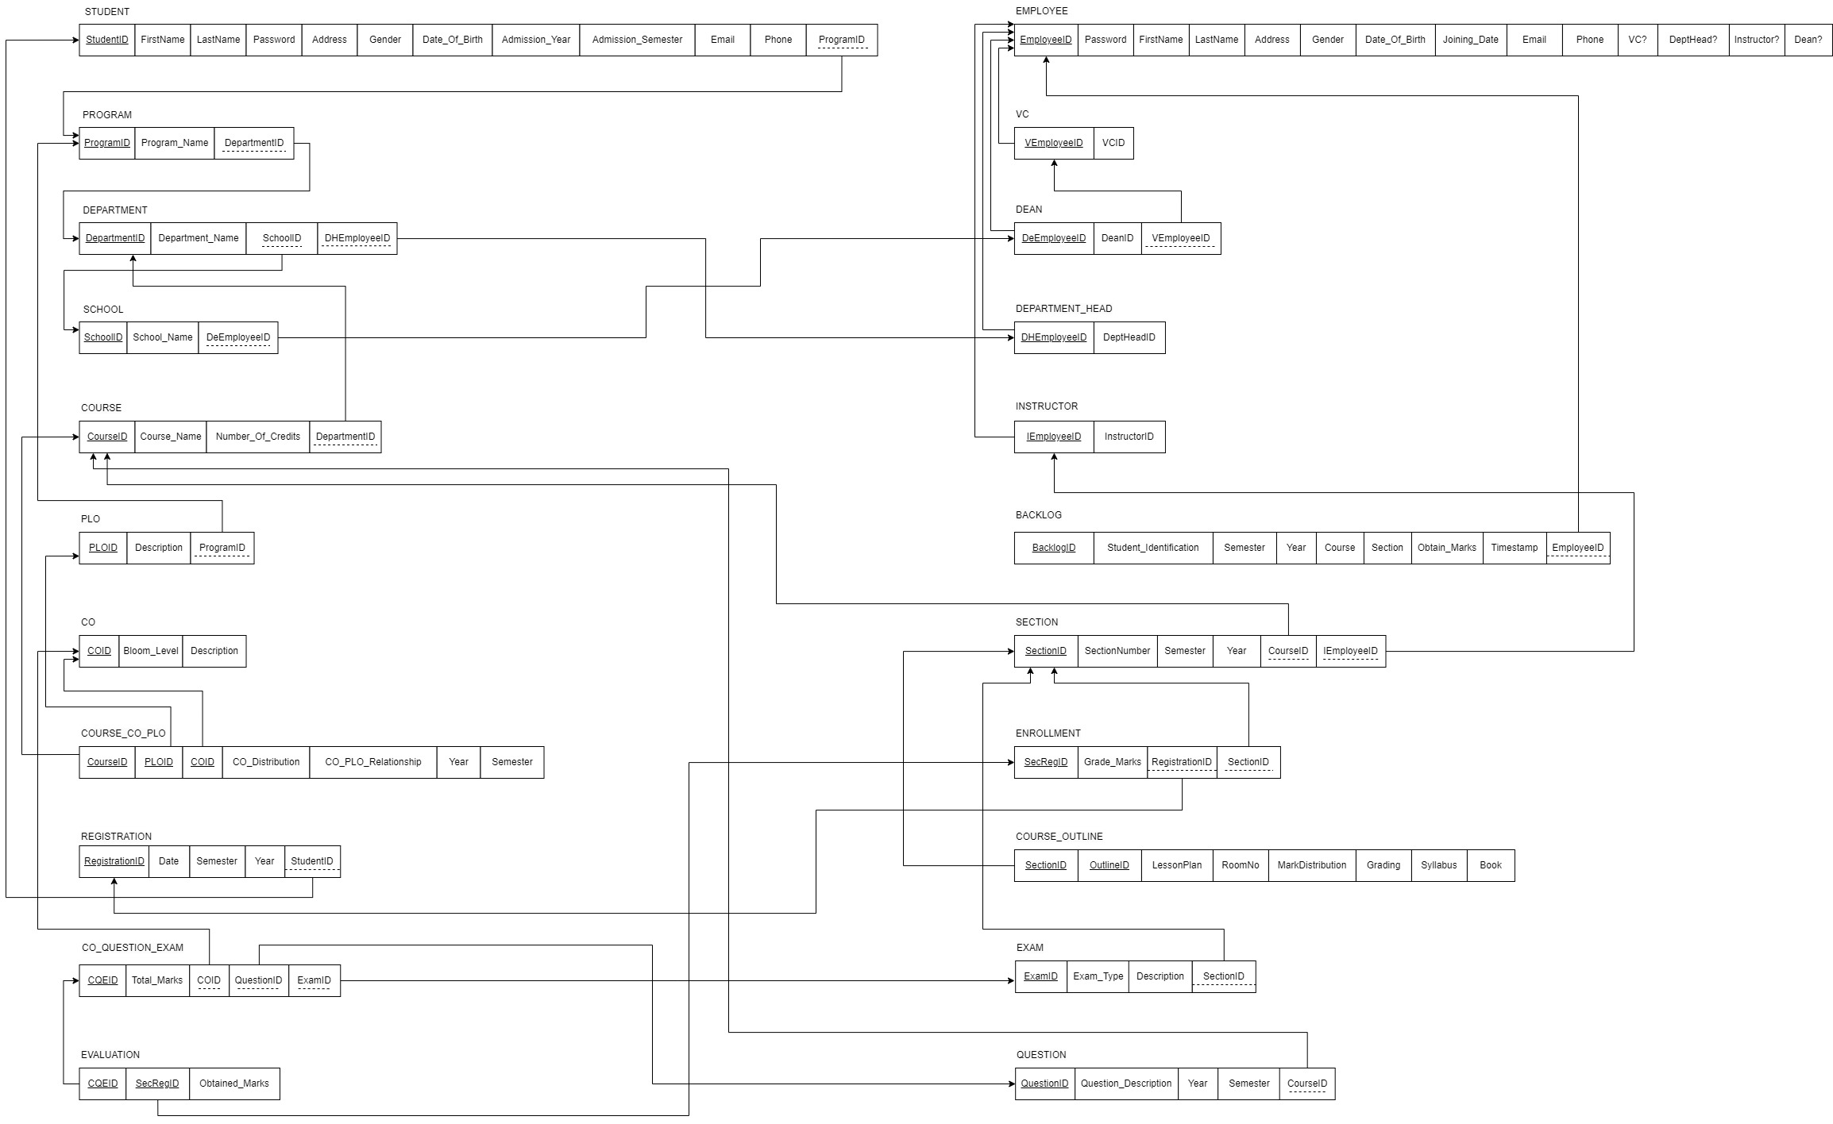
Relational schema

Slide 6
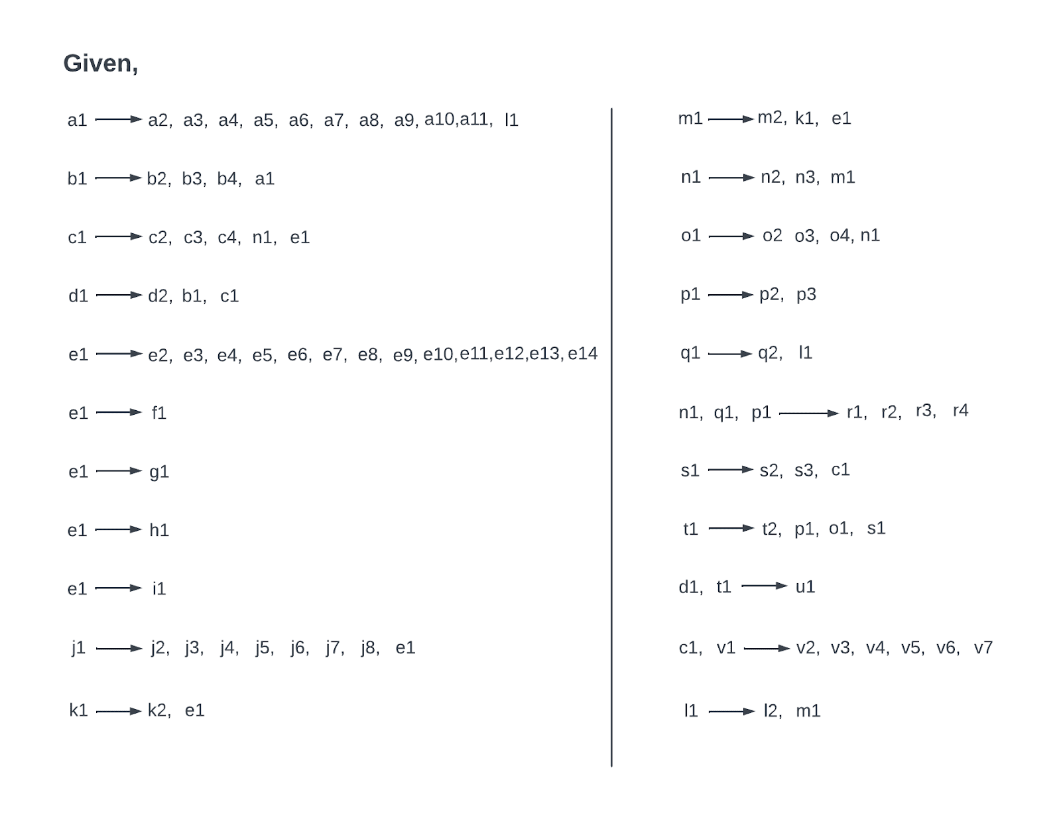
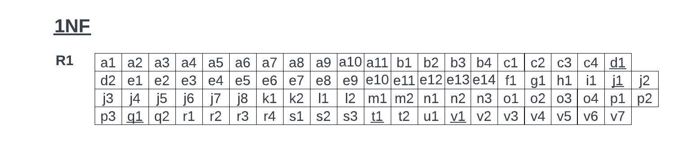
Normalization functional dependencies & primary keys

Slide 7
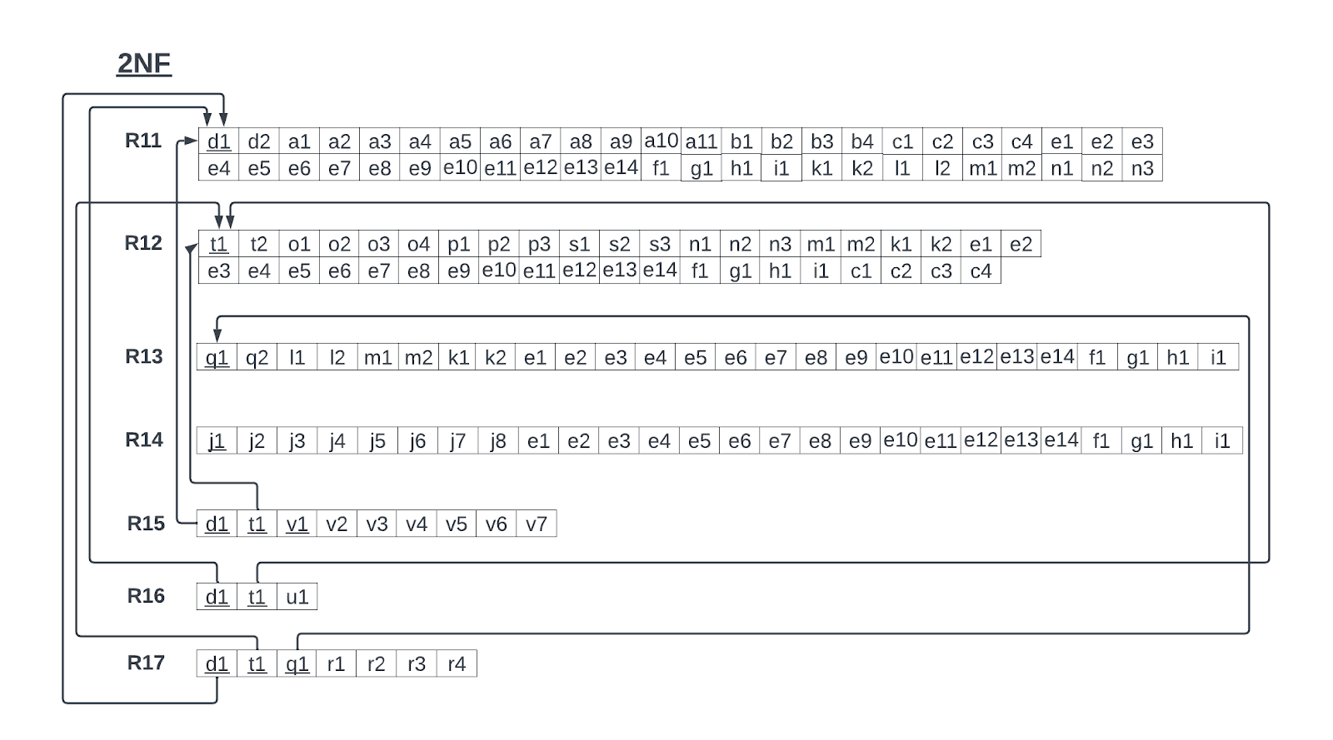
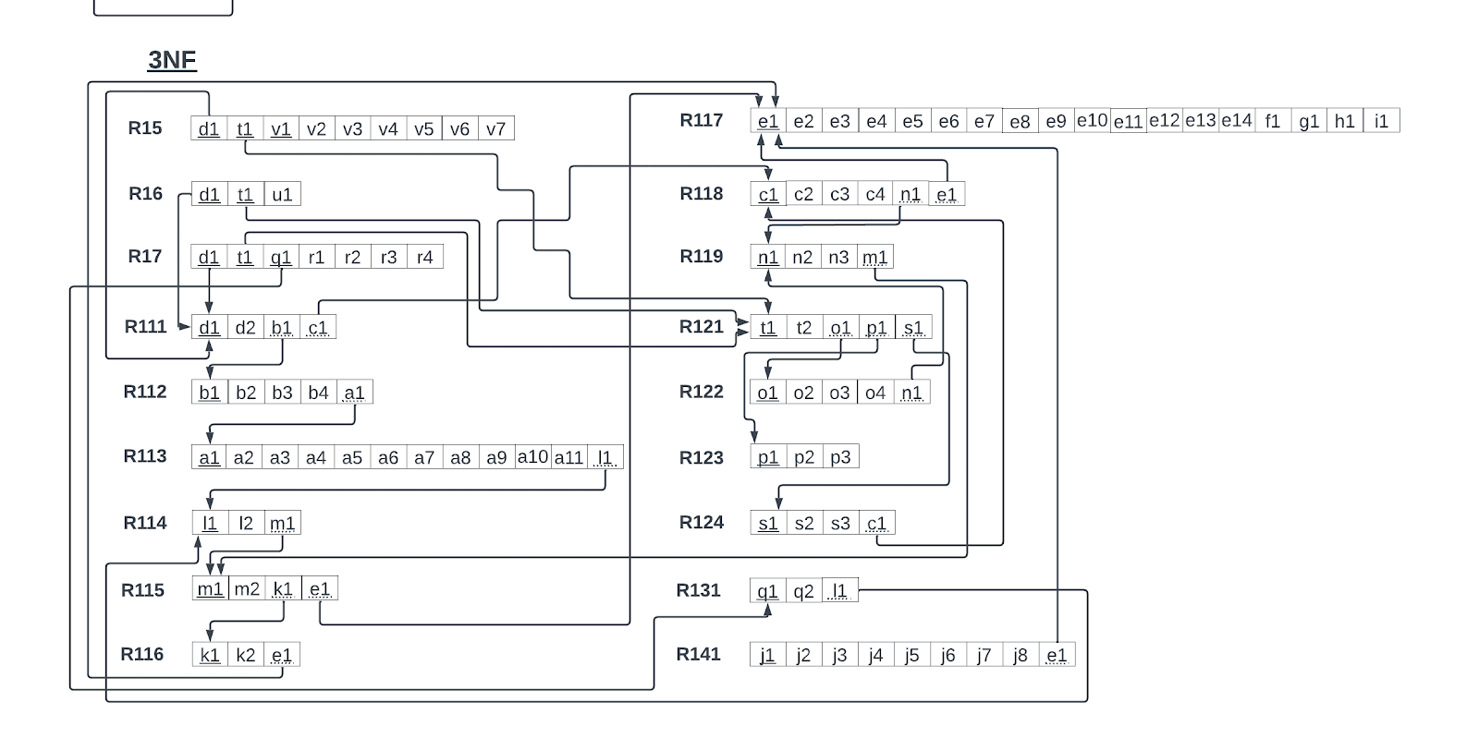

Normalization 2NF, 3NF & BCNF form

